Slide 1

A Project On ‘HydroSense- Water Management & Soil Moisture Level Detection’ Course: Environmental Science (AY 2023-24, Semester II) Submitted by : F. Y. B. Tech. Division: A Batch: A3
P. R. No. | Roll No. | Name of Student | Mobile No. | VIIT Email ID
22311251 | 101145 | Tanushri Chetan Rajput | 8446029351 | tanushri.22311251@viit.ac.in
22311496 | 101149 | Atharva Rajendra Joshi | 9527043551 | atharva.22311496@viit.ac.in
22311517 | 101153 | Revati Tushar Aute | 8208092760 | revati.22311517@viit.ac.in
22311608 | 101158 | Manas Girish Kulkarni | 7972470825 | manas.22311608@viit.ac.in
22311679 | 101161 | Atharva Vishwas Deshpande | 9309358960 | atharva.22311679@viit.ac.in
BRACT’S, Vishwakarma Institute of Information Technology, Pune-48
(An Autonomous Institute affiliated to Savitribai Phule Pune University)
(NBA and NAAC accredited, ISO 9001:2015 certified)

Slide 2
Contents
7. Results & Discussion
8. Conclusion
9. Limitations
10. Future Scope
11. References
1. Abstract
2. Objectives
3. Introduction
4. Experimental Methods Used / Proposed
5. Experimental Details / Procedures
6. Observations & Calculations
101145, 49, 53, 58, 61 , Department of Engineering and Applied Sciences, VIIT, Pune-48

Slide 3
Abstract (Revati)
Our project aims to provide farmers with an efficient water management system. It includes a water storage facility with a connected water level sensor. When the storage is full, the sensor cuts off the water supply to prevent wastage. Additionally, we’ve integrated a soil moisture sensor. When soil moisture is insufficient, water flows from the storage to support crop growth. We’ve powered everything using Solar Energy.
101145, 49, 53, 58, 61, Department of Engineering and Applied Sciences, VIIT, Pune-48

Slide 4
Objectives (Revati)
Our project is aimed to step towards automation in the world of farming. One of the main benefits of automation is increased efficiency, and that is what we are practicing in our project. Automation reduces the need for manual labour, allowing farmers to focus on other tasks that require human expertise. The main objective of our project is to reduce the wastage of water and over-drying of the soil, which we are going to achieve through automation.
Saving Water
Enhanced Water Management
Efficient Water Storage
Water Level Sensor Integration
Relay Integration
Soil Moisture Monitoring
Solar Integration
101145, 49, 53, 58, 61, Department of Engineering and Applied Sciences, VIIT, Pune-48

Slide 5
Introduction (Revati)
Water is undoubtedly the lifeline of human civilization. For irrigation and farming, we need a good supply of water.
In India, this water is mainly obtained from rivers, canals, groundwater systems, aquifers and other sources.
For this, effective management of these water resources is of great importance.
Due to increasing population, and rising industrial demands these water resources have been overburdened and are getting depleted rapidly.
Keeping in mind these modern issues, our project aims to reduce water wastage by using the water level sensor which cuts off the water supply once the storage facility is filled upto the level.
101145, 49, 53, 58, 61, Department of Engineering and Applied Sciences, VIIT, Pune-48

Slide 6
Experimental Methods Used (Joshi)
Experimental Methods Used:
1) Water Level Sensor Integration- Utilized a water level sensor connected to the water tank to regulate water supply. Accordingly, integrated the sensor to deactivate the water pump when the tank is full, preventing overflow of water. 2) Soil Moisture Measuring Mechanism- Integrated a soil moisture sensor in the farm to monitor soil moisture levels. Implemented the automation to trigger water supply from the storage facility when the soil moisture levels drop below threshold.
101145, 49, 53, 58, 61, Department of Engineering and Applied Sciences, VIIT, Pune-48

Slide 7
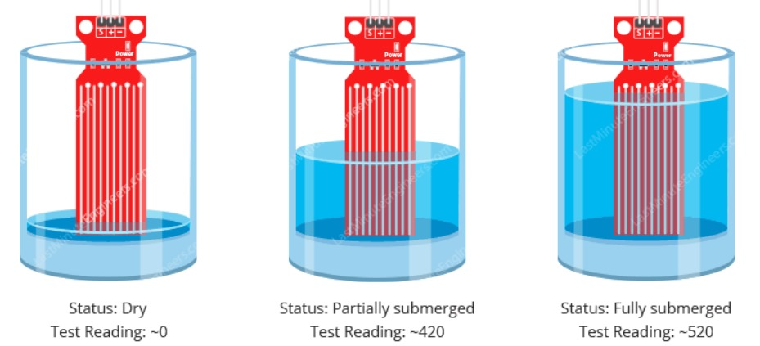
Experimental Methods Used (Joshi)
101145, 49, 53, 58, 61, Department of Engineering and Applied Sciences, VIIT, Pune-48

Slide 8
Experimental Methods Used (Joshi)
The inspiration for this project stems from the software project named AgriPy, which is a Python project focused on Smart Agricultural Monitoring System emphasizing Water management and Soil moisture level detection. 3) Automation Setup- Established a connection between the water level sensor, soil moisture sensor, and the water supply system.
4) Solar Energy Utilization - We’ve powered everything using Solar Energy, making the system sustainable and environmentally friendly.
Applied knowledge gained from Electronics Workshop Practice regarding Relay. Connected a water pump to the Normally Closed terminal of the relay instead of Normally Open to ensure effective water flow.
101145, 49, 53, 58, 61, Department of Engineering and Applied Sciences, VIIT, Pune-48

Slide 9
Experimental Methods Proposed (Joshi)
Experimental Methods Proposed:
Aim to increase the efficiency of energy produced.
101145, 49, 53, 58, 61, Department of Engineering and Applied Sciences, VIIT, Pune-48

Slide 10
Experimental Details (Procedure/s) (Joshi)
1) Setup Construction- Constructed a live working model comprising a water storage facility with a water tank. Installed a water level sensor in the water tank to monitor water levels. 2) Integration of Water Level Sensor- Connected the water level sensor to the water pump system. Programmed the sensor to deactivate the water pump when the water tank reaches capacity. 3) Soil Moisture Sensor Installation- Positioned a soil moisture sensor in the farm to measure soil moisture levels accurately.
101145, 49, 53, 58, 61, Department of Engineering and Applied Sciences, VIIT, Pune-48

Slide 11
Experimental Details (Procedure/s)
101145, 49, 53, 58, 61, Department of Engineering and Applied Sciences, VIIT, Pune-48

Slide 12
Experimental Details (Procedure/s) (Joshi)
4) Automation Configuration- Established a connection between the soil moisture sensor and the water supply system. Programmed the system to initiate water supply from the storage facility when soil moisture levels fall below a predetermined threshold. 5) Testing- Monitored water usage and soil moisture levels over time to assess the system's effectiveness in preventing water wastage and optimizing soil moisture content for crop growth.
6) Solar Energy Utilization- We’ve powered everything using Solar Energy, ensuring the system operates sustainably and reduces environmental impact.
101145, 49, 53, 58, 61, Department of Engineering and Applied Sciences, VIIT, Pune-48

Slide 13
Observations and Calculations (Deshpande)
Solar Panel
Solar panel efficiency=(panel power(in kW)/(panel length*panel breadth))*100
=((1.5*10^(-3))/(11.5*10^(-2)*8.5*10^(-2)))*100
=15.345%
Water Level Sensor
V=3.79V, I=18mA
P=VI=3.79*(18/1000)=68.22mW
Soil Moisture Level Sensor
V=3.47V, I=12mA
P=VI=3.47*(12/1000)=41.64mW
101145, 49, 53, 58, 61, Department of Engineering and Applied Sciences, VIIT, Pune-48

Slide 14
Observations and Calculations (Deshpande)
Battery (Water level sensor)
I=2.5Ah, V=3.81V
P=VI=2.5*3.81=9.525=10W
Battery (Soil moisture level sensor)
I=2.5A, V=4.03V
P=VI=2.5*4.03=10.075=10W
9V DC Supply
I= 0.5A, V= 9V
P=VI=9*0.5= 4.5W
101145, 49, 53, 58, 61, Department of Engineering and Applied Sciences, VIIT, Pune-48

Slide 15
Results and Discussion (Deshpande)
Efficient Water Utilization: Advanced sensors and automation optimize water use, preventing waste and maintaining ideal moisture levels for crop growth efficiently.
Real-time Monitoring: Continuous monitoring of water and soil moisture levels empowers farmers with real-time data for informed decisions on irrigation and water usage.
Cost-effectiveness: HydroSense reduces water waste, optimizes usage, and offers cost-effective solutions for farmers, resulting in savings in water and energy.
Environmental Impact: Solar-powered sustainability reduces reliance on conventional energy, promotes renewable energy adoption, and contributes to environmental conservation.
101145, 49, 53, 58, 61, Department of Engineering and Applied Sciences, VIIT, Pune-48

Slide 16
Results and Discussion (Deshpande)
Project Objective and Achievement: HydroSense empowers farmers with real-time data and automation for efficient water management, achieving robust resource utilization goals.
The Working Model: Our model includes water storage with level and soil moisture, managing supply based on actual conditions, preventing waste
Solar-Powered Sustainability: We integrated solar panels into HydroSense reducing reliance on conventional energy, making it eco-friendly, greener, and cost-effective for farmers.
Key Features: HydroSense promotes sustainability with features like efficient water use, practical demonstration, and scalability for widespread adoption in agricultural communities.
16
101145,49,53,58,61, Department of Engineering and Applied Sciences, VIIT, Pune-48

Slide 17
Conclusion (Manas)
HydroSense is our answer to sustainable farming in a world facing water scarcity and climate change.
It’s a reliable system that optimizes water usage, fostering environmental awareness among farmers. In essence, HydroSense ensures the resilience of our agricultural practices, safeguarding our future.
And as we conclude, remember, with HydroSense, we enhance, a future bright and advanced. With HydroSense as our guide, we stride with pride, for a future where sustainability and prosperity coincide.
101145, 49, 53, 58, 61, Department of Engineering and Applied Sciences, VIIT, Pune-48

Slide 18
Limitations (if applicable) (Tanushri)
Sensor Accuracy: The accuracy of the soil moisture and water level sensors may vary based on environmental conditions, soil types, and calibration, potentially leading to inaccurate readings and inefficient water management.
Maintenance Requirements: Regular maintenance and calibration of sensors and components are essential to ensure accurate readings and proper functioning of the system, which could be a challenge for farmers with limited technical knowledge or resources.
Weather Dependence: The system's effectiveness may be influenced by weather conditions such as heavy rain or drought, which can affect soil moisture levels and water usage patterns, leading to suboptimal water management.
Cost: The cost of components and assembly may be prohibitive for small-scale farmers
101145, 49, 53, 58, 61, Department of Engineering and Applied Sciences, VIIT, Pune-48

Slide 19
Future Scope (Manas)
1. Customization and Adaptability
2. Data-Driven Insights
3. Community Outreach and Education
4. Scaling Up and Partnerships
5. Beyond Agriculture
6. Global Impact
101145, 49, 53, 58, 61, Department of Engineering and Applied Sciences, VIIT, Pune-48

Slide 20
References (Tanushri)
https://ieeexplore.ieee.org/abstract/document/7818550
Water Level Sensor - Investigate the design of a water level sensor device that is able to detect and control the level of water in a certain water tank or a similar water storage system.
- By IEEE
https://academicjournals.org/journal/SRE/article-full-text-pdf/4644D6C20216.pdfBy Academic Journals
Soil Moisture Sensor - A wireless application of drip irrigation automation supported by soil moisture sensors.
-By Academic Journals
101145, 49, 53, 58, 61, Department of Engineering and Applied Sciences, VIIT, Pune-48

Slide 21
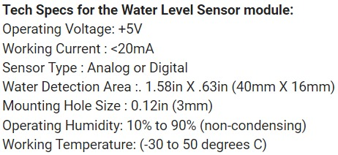
References (Tanushri)
https://www.biomaker.org/block-catalogue/2021/12/17/water-level-sensor-tzt-water-level-sensor
101145, 49, 53, 58, 61, Department of Engineering and Applied Sciences, VIIT, Pune-48

Slide 22
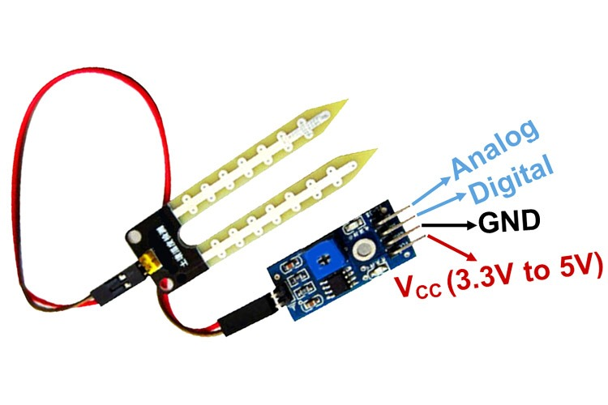
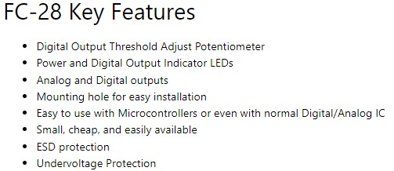
References (Tanushri)
https://www.datasheethub.com/fc-28-soil-moisture-sensor-module/
https://components101.com/modules/soil-moisture-sensor-module
101145, 49, 53, 58, 61, Department of Engineering and Applied Sciences, VIIT, Pune-48

Slide 23
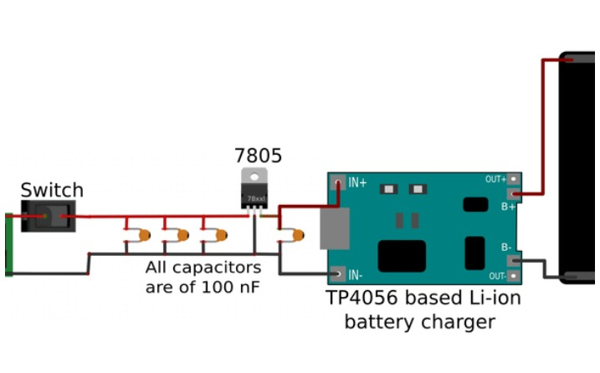
References (Tanushri)
https://www.instructables.com/DIY-Lithium-ion-Battery-Charger/
101145, 49, 53, 58, 61, Department of Engineering and Applied Sciences, VIIT, Pune-48

Slide 24
Thank You!
101145, 49, 53, 58, 61, Department of Engineering and Applied Sciences, VIIT, Pune-48

